Slide 1
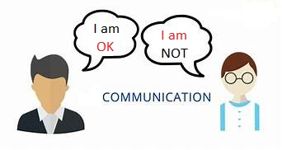
Communication Skills: The Basics
Dr Sagarika Dutta

Slide 2
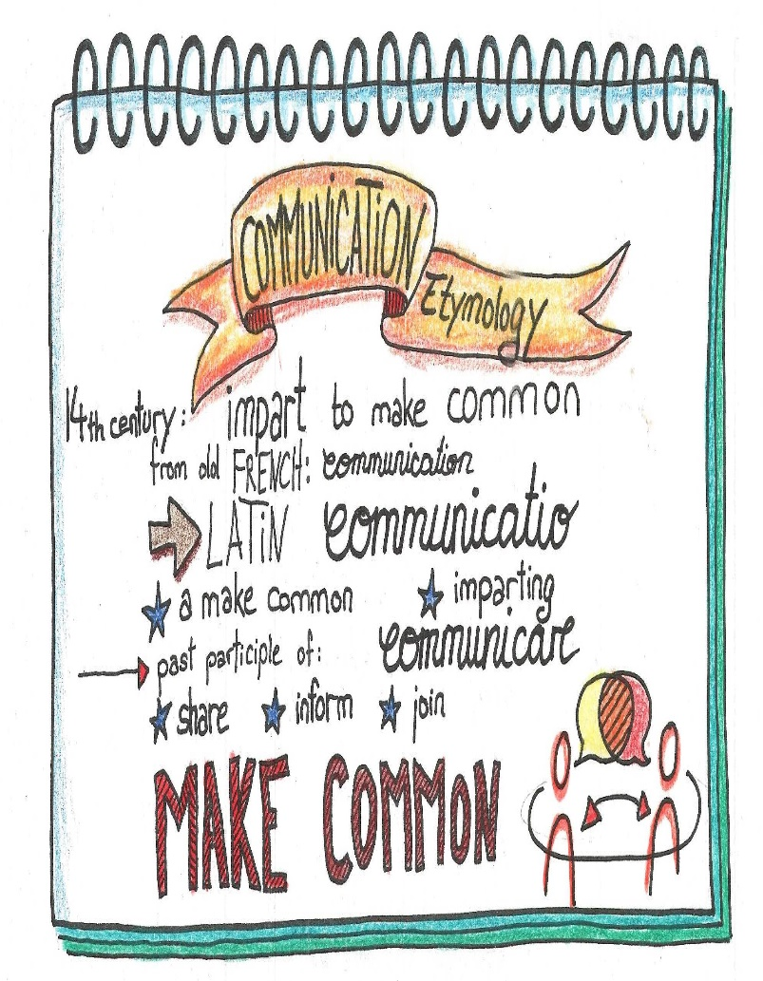
Communication: Etymology
The root is derived from Latin communicare, which means to share
It is the act of imparting, discussing, conferring
It is the noun of action from past-participle of “communicare”
Notes:
2

Slide 3
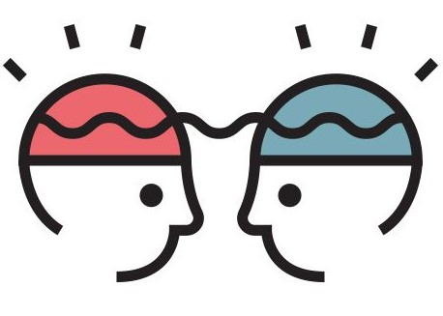
Understanding
To understand is to perceive, to interpret, and to relate our perception and interpretation to what we already know.
Notes:
4

Slide 4
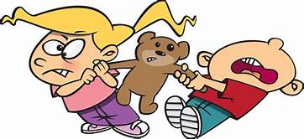
Sharing
Sharing means doing something together with one or more people.
In communication, sharing occurs when you convey thoughts, feelings, ideas, or insights to others.
Notes:
4

Slide 5
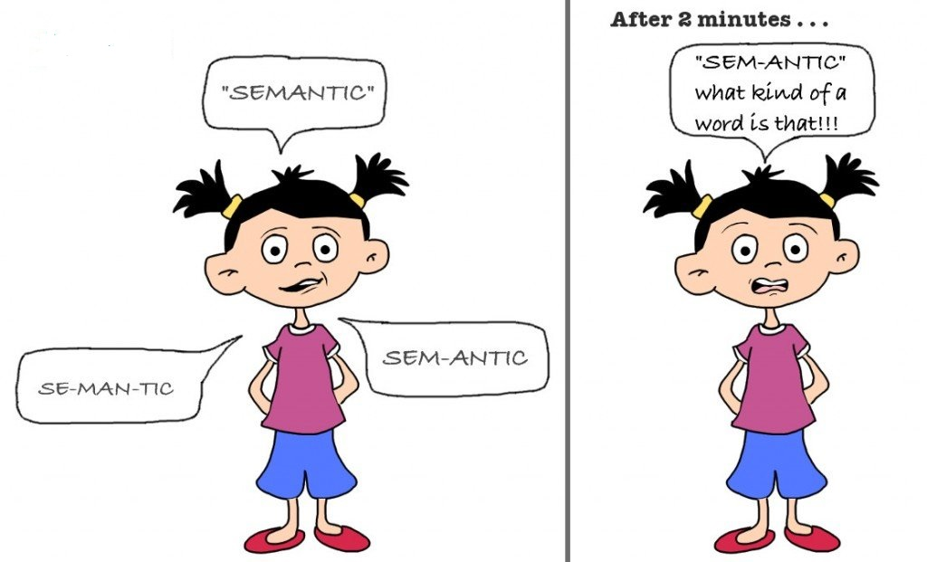
Meaning
Meaning is what we share through communication
Notes:
3

Slide 6
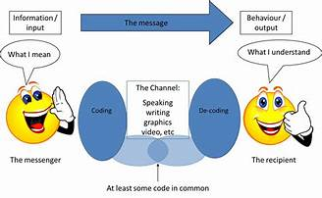
Eight Essential Components of Communication
Source
Message
Channel
Receiver
Feedback
Environment
Context
Interference
Notes:
6

Slide 7
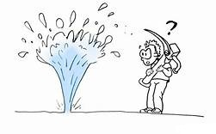
Source
The source imagines, creates, and sends the message. In a public speaking situation, the source is the person giving the speech. He or she conveys the message by sharing new information with the audience. The speaker also conveys a message through his or her tone of voice, body language, and choice of clothing. The speaker begins by first determining the message—what to say and how to say it
Notes:
7

Slide 8
Source
The second step involves encoding the message by choosing just the right order or the perfect words to convey the intended meaning. The third step is to present or send the information to the receiver or audience. Finally, by watching for the audience’s reaction, the source perceives how well they received the message and responds with clarification or supporting information.
Notes:
8

Slide 9

Message
“The message is the stimulus or meaning produced by the source for the receiver or audience.”
When you plan to give a speech or write a report, your message may seem to be only the words you choose that will convey your meaning. But that is just the beginning. The words are brought together with grammar and organization. You may choose to save your most important point for last
Notes:
9

Slide 10
The message also consists of the way you say it—in a speech, with your tone of voice, your body language, and your appearance—and in a report, with your writing style, punctuation, and the headings and formatting you choose. In addition, part of the message may be the environment or context you present it in and the noise that might make your message hard to hear or see.

Slide 11

Channel
Spoken channels include face-to-face conversations, speeches, telephone conversations and voice mail messages, radio, public address systems, and voice over Internet protocol (VoIP). Written channels include letters, memorandums, purchase orders, invoices, newspaper and magazine articles, blogs, e-mail, text messages, tweets, and so forth
“The channel is the way in which a message or messages travel between source and receiver
Notes:
11

Slide 12
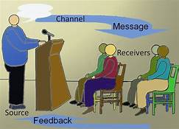
Receiver
“The receiver receives the message from the source, analyzing and interpreting the message in ways both intended and unintended by the source.”
Notes:
12
23
23

Slide 13
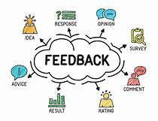
Feedback
Feedback is composed of messages the receiver sends back to the source. Verbal or nonverbal, all these feedback signals allow the source to see how well, how accurately (or how poorly and inaccurately) the message was received. Feedback also provides an opportunity for the receiver or audience to ask for clarification, to agree or disagree, or to indicate that the source could make the message more interesting. As the amount of feedback increases, the accuracy of communication also increases
Notes:
13

Slide 14
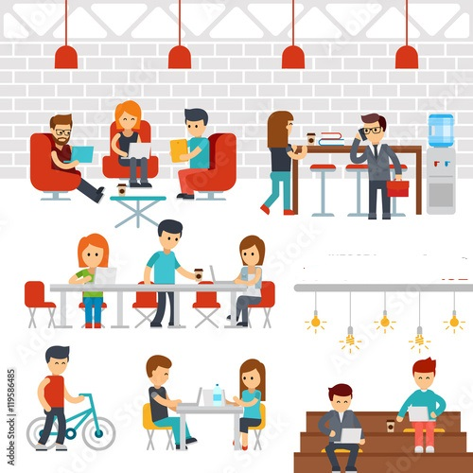
Environment
“The environment is the atmosphere, physical and psychological, where you send and receive message
Notes:
14

Slide 15
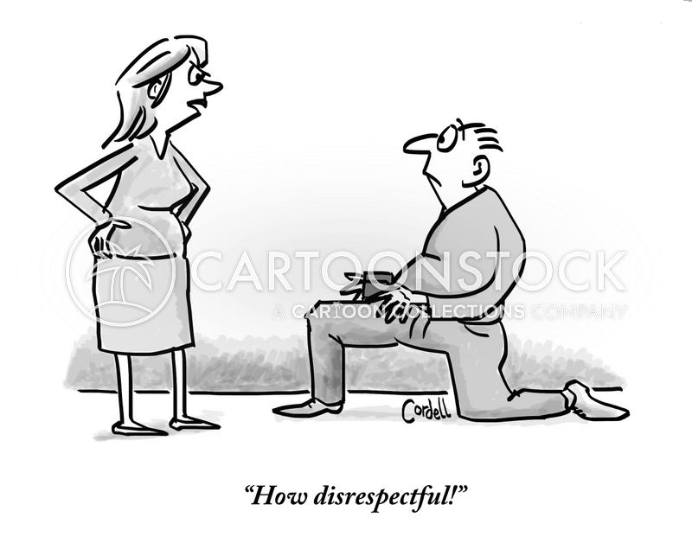
Context
“The context of the communication interaction involves the setting, scene, and expectations of the individuals involved.”
Context is all about what people expect from each other, and we often create those expectations out of environmental cues.
Notes:
15

Slide 16
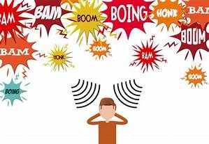
Interference
Interference, also called noise, can come from any source. “Interference is anything that blocks or changes the source’s intended meaning of the message
Notes:
16

Slide 17
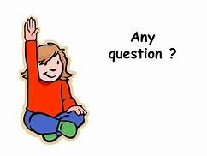

Slide 18


